Slide 1
GUI Test Automation for Eclipse RCP Applications
Phil Quitslund, Senior Architect
Dan Rubel, Chief Technology Officer
Instantiations, Inc.
November 9, 2006

Slide 2
Overview
UI testing challenges
Solutions
  Manual UI Testing
  Abbot
  TPTP
  WindowTester
Summary & Comparison
Real World Experience
  BEA
  Instantiations

Slide 3

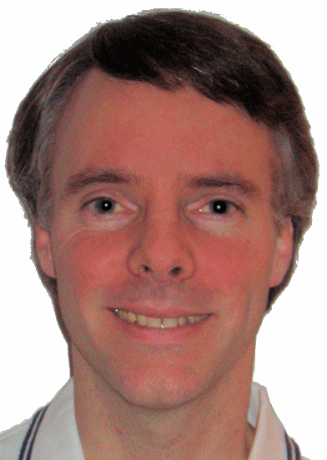
Who Are We?
Phil Quitslund
  Senior Architect for Instantiations
  Eclipse Research Community Member
    Eclipse Support for Java Traits
Dan Rubel
  Chief Technology Officer for Instantiations
  Author “Eclipse: Building Commercial Quality Plug-ins“
  Developer and architect of VA Assist Enterprise, CodePro and over a dozen other commercial software products
Phil & Dan
  Co-architects of WindowTester

Slide 4





Instantiations
Founded in 1997, Headquarters in Portland, OR
Leading edge development tools for professional Java developers
  VA Assist Enterprise (Smalltalk & Java)
  CodePro Product Line (AnalytiX, PlusPak, etc.)
  WindowBuilder Pro (SWT & Swing Designer)
  RCP Developer (WindowTester, RCP Packager)
Extensive Eclipse experience
  One of first IBM partners briefed on Eclipse in 1999
  Technical development since January 2000 (>6.5 years)
  First commercial Eclipse & WSAD add-on (Nov. 2001)
  First product certified as “Ready for WebSphere Studio”
  Eclipse Foundation member & major contributor
  Eclipse Projects: KOI (Collaboration), Pollinate (Beehive)
WindowBuilder™
WindowTester™

Slide 5
Conventional Wisdoms
Obstacles
  UI testing is hard
  Tests are tedious to write
  Tests are difficult to maintain
Yet
  Catching bugs earlier is more cost effective
  Bugs caught by customers is most costly option and bad publicity
So… how should you test your GUI ?

Slide 6
Solutions
Manual Testing
  Written prose script describing steps and expected results
Abbot
  Open source library for upon which Java based GUI tests are built
TPTP
  Eclipse tool for recording XML based GUI tests
WindowTester
  Eclipse tool for recording Java JUnit based GUI tests

Slide 7
Manual UI Testing
Process
  Write a script describing actions and expected results
  Hire QA staff or outsource to execute scripts
Problems
  Labor intensive ($$$)
  Prone to errors
  Typically done just before release if at all
  Bugs are caught late in development cycle if at all

Slide 8
Automated UI Testing
Process
  Write a code to exercise GUI and assert expected results
  Launch tests manually
  Hook test execution into automated build process
Problems
  Additional work for developers
  Culture
Results
  Tests executed earlier and more often
  Bugs caught earlier in the cycle are less costly to fix... better product

Slide 9
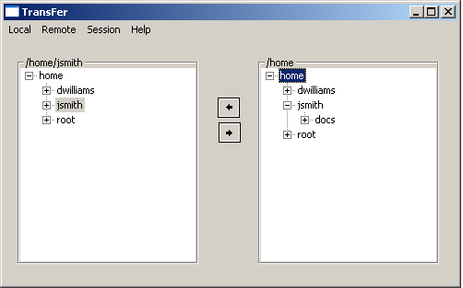
TransFer – Sample GUI under test
Introducing TransFer, our application under test
Simple File
Transfer Application
Gets and Puts Files
using FTP, SSH, etc.

Slide 10
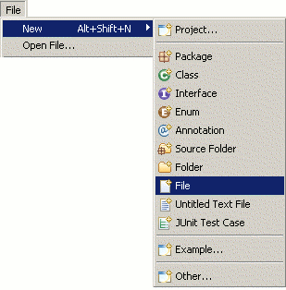
Challenge 1 : Widget Location
How to locate the intended widget?
Can be tricky to disambiguate…
  Identical Items in a Widget (menu, tree)
  Identical Widgets

Slide 11
Challenge 2: Verification
How to verify that aspects of the UI are as you expect them?
How to verify state changes as a result of UI operations?
Menu Exists
Label reflects selected Item
Tree Node Exists

Slide 12
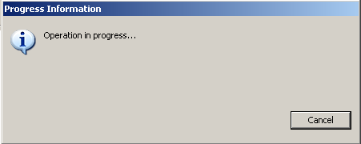
Challenge 3: Staying in Sync
Making playback robust in the face of unpredictable timing issues
For example:
  new ProgressMonitorDialog(shell).run(true, true, op);

Slide 13
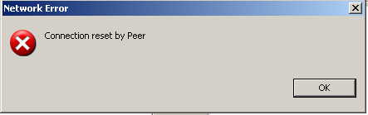
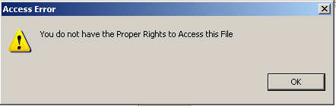
Challenge 4: Handling the Unpredictable
Some things are hard to
predict
Not all unpredictable events
are error conditions!

Slide 14

Challenge 5: Platform Differences
linux
Labels might be different
  Win32 = Alt+Shift+N
  Linux = Shift+Alt+N
Focus Differences
  Win32 = Focus independent of mouse (modal dialog always on top)
  Linux = Focus follows mouse location (modal dialog may not have focus)
Default selection event…
  Win32 = double-click selects all text in Text
  Linux = double-click selects word in Text
Tree Item Selection (can’t ask SWT for x,y location of checkbox, so…)
  Win32 = arrow left then space to check tree item
  Linux = arrow left 3 times then space to check tree item
Eclipse UI changes over time 3.0… 3.1… 3.2… etc.
  Eclipse 3.1 = path to tree item in new project wizard is “Simple/Project”
  Eclipse 3.2 = path to tree item in new project wizard is “General/Project”
win32

Slide 15
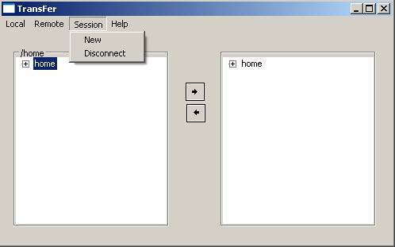

Challenge 6: Test Maintenance
Introduce a change to the UI... How to evolve the tests?
  Example: Changing Item Labels:

Slide 16
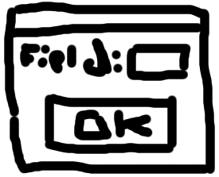


Challenge 7: Test Driven Development
How to write tests for a UI that is
incomplete or does not yet exist?

Slide 17
Abbot
“Abbot is a simple framework for unit and functional testing of Java GUIs. Facilitates generating user actions and examining component state.”
Open Source (CPL)
Hosted on Sourceforge: http://sourceforge.net/projects/abbot
Base Distribution Supports AWT/Swing
SWT, Eclipse Support provided as plug-ins

Slide 18
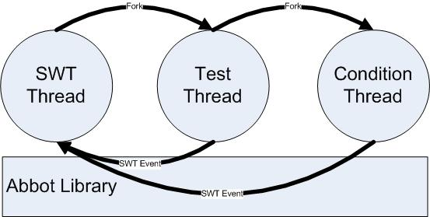
Abbot Thread Overview
SWT Thread – access widgets on SWT thread only
Test Thread – executes test and asserts results
Condition Thread – handles for unpredictable situations

Slide 19
Abbot Test Ingredients
To write Abbot tests you must absorb some Abbot framework details:
ActivePDETestSuite – forks test thread and manages SWT thread
BasicFinder and Matcher – locates widgets to manipulate
  ClassMatcher, IndexMatcher, NameMatcher, TextMatcher, …
Tester – access and manipulate widgets from test thread
  ButtonTester, MenuItemTester, TreeItemTester, …
Robot – utility methods
  wait(condition), waitForIdle(), delay(milliseconds), …

Slide 20
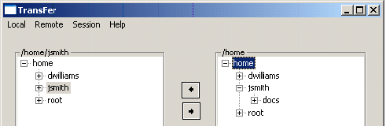
Abbot Test Example
public void test_TransFer() {
finder = new BasicFinder(new TestHierarchy(display));
tree = finder.find(new IndexMatcher(new ClassMatcher(Tree.class), 0));
tester = new TreeItemTester();
tester.actionClickTreeItem("home/jsmith/docs/report.pdf", tree, 1);
selection = new TreeTester().getSelection(tree);
// assert selection
// assert application state change
}

Slide 21
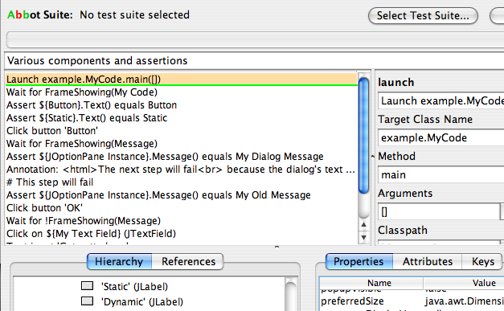
Abbot and Costello – Recording Tests
Costello provides Abbot based
recording and playback
UI to record test script
Engine to playback test script
Script is stored as XML
BUT only exists for Swing…
not for SWT (yet)
<AWTTestScript>
<component class="java.awt.Button" id="?" index="3" tag="?" window="Applet Viewer 0"/>
<component class="sun.applet.AppletViewer" hOrder="0" id="Applet Viewer 0" tag="Applet Viewer: example.SimpleApplet"/>
<component class="java.awt.Dialog" id="Dialog" title="Dialog"/>
<component class="java.awt.Button" id="High Button" tag="High" window="Applet Viewer 0"/>
<component class="java.awt.Button" id="Low Button" tag="Low" window="Applet Viewer 0"/>
<component class="java.awt.Label" id="Press a button" tag="Press a button" window="Applet Viewer 0"/>
<component class="example.SimpleApplet" id="SimpleApplet Instance" window="Applet Viewer 0"/>
<component class="java.awt.Label" id="This is a dialog" index="0" tag="This is a dialog" title="Dialog"/>
<component class="java.awt.TextField" id="textField" index="4" tag="textField" window="Applet Viewer 0"/>
<appletviewer archive="lib/example.jar" code="example.SimpleApplet" height="250" width="250"/>
<action args="textField" class="java.awt.TextComponent" method="actionFocus"/>
<action args="textField,some text" class="abbot.tester.ComponentTester" method="actionKeyString"/>
<assert component="High Button" method="isVisible"/>
<action args="High Button" method="actionClick"/>

Slide 22
Abbot Test Integration
Abbot is easy to integrate
Add a few jars / plug-ins
Based upon JUnit
Easy to integrate into automated build systems
  Ant
  Cruise Control
  Maven
  …

Slide 23
Challenge 1: Finding Widgets (Abbot)
Start with instance of BasicFinder searching over the widget hierarchy
  finder = new BasicFinder(new TestHierarchy(display));
Use matchers to locate a specific widget
  tree = finder.find(new IndexMatcher(new ClassMatcher(Tree.class), 1));
Matcher Hierarchy
  ClassMatcher – matches component by class
  CompositeMatcher – combine several matchers
  NameMatcher – matches component by name stored in widget’s SWT data
  TextMatcher – matches Text widget with specific text
  … etc …
Widget
Matcher

Slide 24
Challenge 2: Verification (Abbot)
How to verify that aspects of the UI are as you expect them?
  Widget existence is verified when accessing the widget
How to verify state changes as a result of UI operations?
  Abbot tests are simply JUnit tests, so…
    selection = treeTester.getSelection(tree);
    assertEquals(1, selection.length);
    assertEquals("report.pdf", treeTester.getText(selection[0]));

Slide 25
Challenge 3: Staying In-Sync (Abbot)
Pause the test until the operation completes
  Robot.wait(new Condition() {
  boolean inProgress = true;
  public boolean test() {
  Display.getDefault().syncExec(new Runnable() {
  public void run() {
  Shell shell = Display.getDefault().getActiveShell();
  if (shell == null || !shell.getText().equals("Progress Information"))
  inProgress = false;
  }
  });
  return !inProgress;
  }
  });
Access Shell
on SWT Thread
Check Operation
In Progress

Slide 26
Challenge 3: Staying In-Sync (Abbot)
Some problems we have seen …
Clicking a button that opens a progress monitor dialog can cause a long delay
  buttonTester.actionClick(button);
Selecting a tree item that opens a progress monitor dialog can prevent selection
  try {
  treeTester.actionClickTreeItem("home/jsmith/docs/report.pdf", tree, 1);
  }
  catch (WaitTimedOutError e) {
  // handle exception
  }

Slide 27
Challenge 4: Handling the Unpredictable (Abbot)
How does a test handle an unexpected dialog?
For example:
  MessageDialog.openWarning(shell, "Access Error", message);

Slide 28
Challenge 4: Handling the Unpredictable (Abbot)
Fork a thread to dismiss expected but unpredictable dialogs
  final Thread handleWarningThread = new Thread("Handle Warning Thread") {
  final Object lock = new Object();
  public void run() {
  while (true) {
  Display.getDefault().asyncExec(new Runnable() {
  public void run() {
  lock.notifyAll();
  Shell shell = Display.getDefault().getActiveShell();
  if (shell != null && shell.getText().equals("Access Error")) {
  Button button = (Button) finder.find(new ClassMatcher(Button.class));
  new ButtonTester().actionClick(button);
  }
  }
  });
  lock.wait();
  Thread.sleep(500);
  }
  }
  };
  handleWarningThread.setPriority(Thread.MAX_PRIORITY);
  handleWarningThread.setDaemon(true);
  handleWarningThread.start();
Access Shell
on SWT Thread
Identify
Dialog
Thread ends
when Test ends

Slide 29
Challenge 5: Platform Differences (Abbot)
Labels might be different
  Use regular expressions for New menu item
  "&New\t(Shift\\+Alt|Alt\\+Shift)\\+N/P&roject...”
Default selection event
  Abbot tests are JUnit tests, so use Java syntax such as
  clickCount = Platform.isWindows() ? 2 : 3;
  textTester.actionClick(text, 3, 3, "", clickCount);
Eclipse UI changes over time 3.0… 3.1… 3.2… etc.
  Use regular expressions to smooth over path differences
  "(Simple|General)/Project“

Slide 30
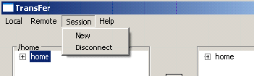
Challenge 6: Maintaining Tests (Abbot)
Text changes involve minor code changes
  From:
  InvokeMenuItem.invoke(“Session/Disconnect", shell);
  To:
  InvokeMenuItem.invoke(“Session/Terminate", shell);
Naming widgets reduces changes due to location changes
  From:
  tree = finder.find(new IndexMatcher(new ClassMatcher(Tree.class), 0));
  To:
  tree.setData(“name”, “myTree”)
  …
  tree = finder.find(new NameMatcher("myTree"));
Code in
Class under test
Code in
Test

Slide 31
Challenge 7: Test Driven Development (Abbot)
How to write tests for a UI that is
incomplete or does not yet exist?
Abbot tests are JUnit tests,
so writing new tests by hand is possible

Slide 32
Abbot Pros and Cons
Pros:
Very flexible… full expressive power of java
Easy to integrate… just a few jars
Cons:
No recorder for Abbot SWT (yet)… Costello only exists for Swing
Steep learning curve… must understand the API and its limitations
Threading issues… must explicitly manage condition threads

Slide 33

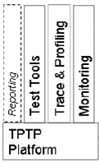
TPTP Overview
Top-level Eclipse Technology Project
  Platform
  Monitoring
  Tracing, Profiling
  Testing
http://www.eclipse.org/tptp
TPTP Test Tools
Platform for test creation, deployment, execution and results analysis
Automatable Execution framework
  Local or distributed execution of tests
Results analysis
  Execution History viewer; BIRT based reporting system
AGR = Automated GUI Recording/Playback

Slide 34
TPTP AGR Overview
GUI events recorded for playback (AGR – Automated GUI Recorder)
  Playback script (XML)
Two kinds of Assertion/Verification
  Verification by Selection
    Verify that a widget exists by selecting it
    Absence at playback will trigger a failure
    (Note this is a binary test)
  Verification Hooks
    Call outs from the script to methods in Java Classes
    Hooks surface an element of the UI to the verification class as context
    Verification classes use JUnit-style assertions to verify aspects of UI state

Slide 35

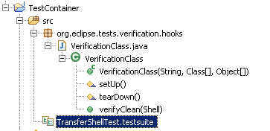
TPTP AGR Script Example
1. Launch Recording Session
2. Record Actions
AGR
3. Generate Test
2
Verification Hook
1
Test Script

Slide 36
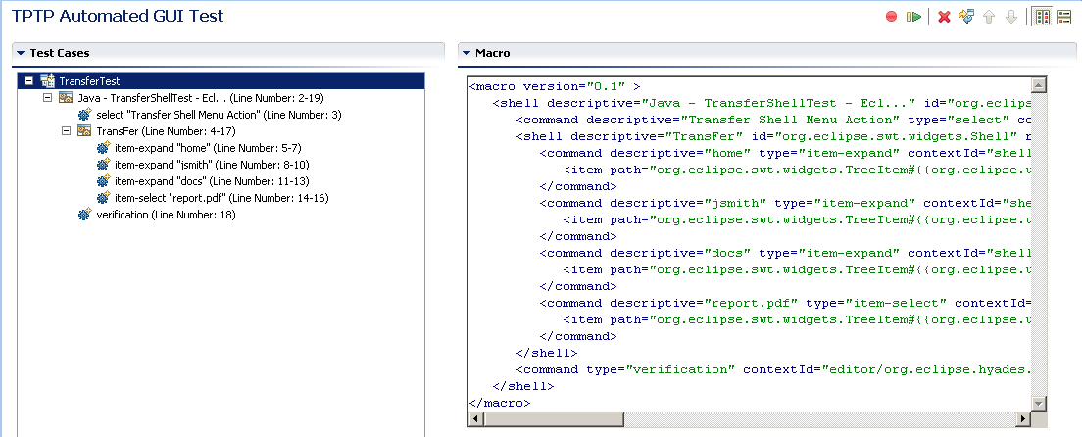
TPTP AGR Script Ingredients

Slide 37
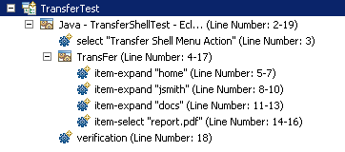
TPTP AGR Script Ingredients
Invoke menu
Select menu item
Select tree item
Verify state

Slide 38
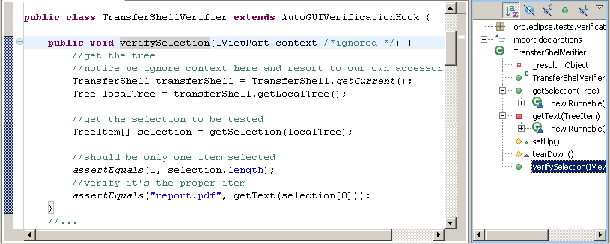
TPTP AGR Script Verification
Verification Hook: Assertion Class called from Test Script

Slide 39
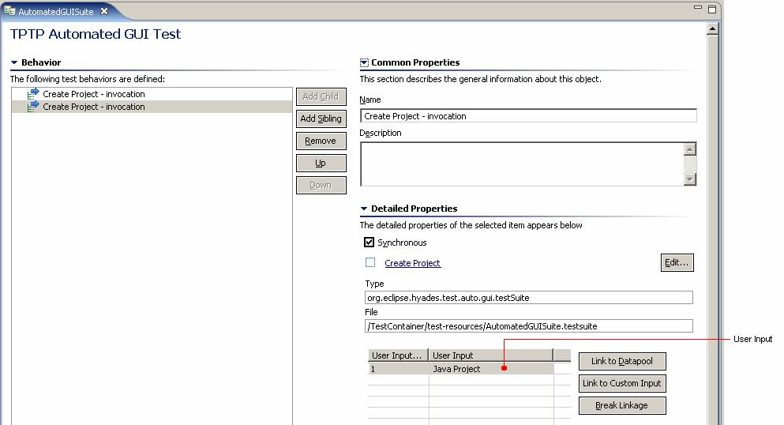
TPTP AGR Datapools
Datapools allow user input to be parameterized
Same Test:
Different Project names

Slide 40
TPTP AGR Test Integration
TPTP framework required
(relatively heavyweight)
Tests can be executed via ant
(custom ant tasks provided)
Should play nice with automated build scenarios
(some assembly required)

Slide 41
Challenge 1: Finding Widgets (TPTP AGR)
<shell descriptive="Java - TransferShellTest - Ecl..."
id="org.eclipse.ui.internal.WorkbenchWindow" return-code="-1" >
<command descriptive="Transfer Shell Menu Action" type="select" contextId="menus"
widgetId="org.eclipse.ui.internal.ActionSetContributionItem#{{Transfer-&amp;Transfer}}-
{{0.8}}{{5|0}}-{{0.6}}{{true}}-{{0.1}}{{1}}-{{0.1}}{{first}}-{{0.2}}{{last}}-{{0.2}}" />
User-customizable Widget Resolvers
  Associate handles with widgets
  Contributed to eclipse runtime
Widget
Identifier
<class name = "org.eclipse.debug.core.ILaunchConfigurationType"
matchThreshold = "7.0">
<method name = "getPluginIdentifier" weight = "0.2"/>
<method name = "getSourcePathComputer" weight = "0.1"/>
<method name = "getCategory" weight = "0.1"/>
<method name = "getIdentifier" weight = "0.5"/>
</class>

Slide 42
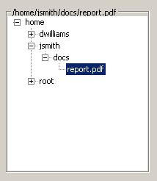
Challenge 2: Verification (TPTP AGR)
Verification by Selection
quick and dirty verification that widget in question exists
can only verify existence not enablement, toggle state, text, etc.

Slide 43

Challenge 2: Verification (TPTP AGR)
Verification Hook
  Assertion class called from Test Script
org.junit
Pass in Context:
Editor,
ViewPart,
Shell
Access and
Assert State
Context Specified
during recording
Custom accessors
JUnit assertions

Slide 44
Challenge 3: Staying In-Sync (TPTP AGR)
TPTP provides a wait:
  <command type="wait" />
  Internal sync mechanism
Problem: not pluggable
Many flavors of wait:
  UI idle (no Display events to consume)
  Workspace idle (no jobs to process)
  n milliseconds
  Some condition to become true

Slide 45
Challenge 4: Handling the Unpredictable (TPTP AGR)
Only place to participate in test
execution is verification hooks
Could conceivably tailor a verifier that checked for conditions
… and insert it at every step (!)
Could conceivably launch a special Condition-handling thread
but this might clash with the main test thread

Slide 46
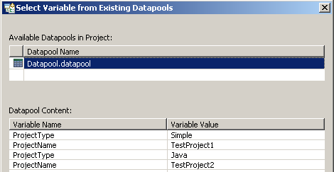
Challenge 5: Platform Differences (TPTP AGR)
Datapools
  Parameterize INPUT
  If input is OS-dependent,
    ideal means of variation
Limitation:
  Many variations are not in input
  No meta language to handle
  command, widget-id variations in XML script
  Need meta datapools!
linux
win32

Slide 47
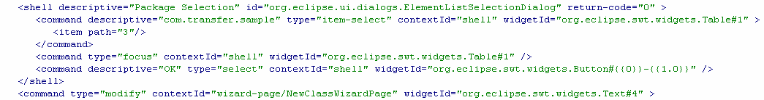
Challenge 6: Maintaining Tests (TPTP AGR)
Again, if the variation is in user
input, Datapools are excellent
But, not so for UI changes…
UI Changes need to be managed at the script level…

Slide 48
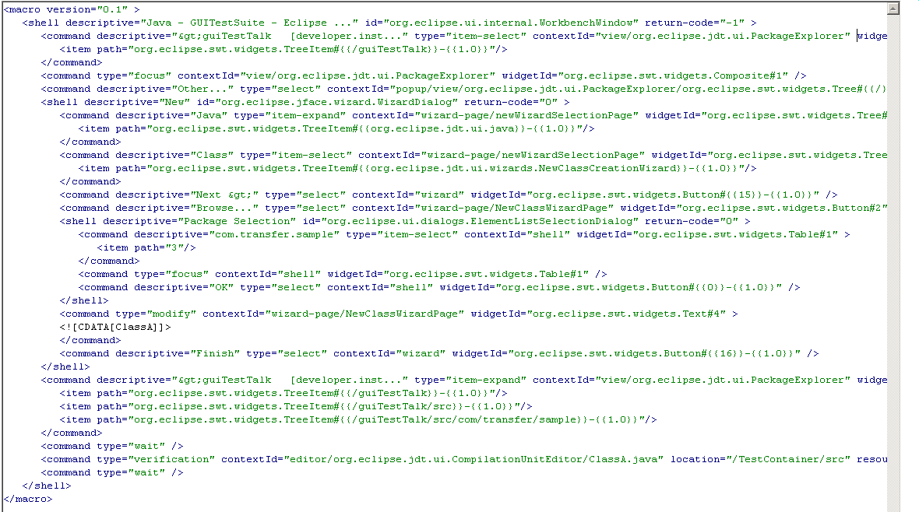
Challenge 6: Maintaining Tests (TPTP AGR)*
YIKES!
* Model view is read-only

Slide 49
Challenge 7: Test Driven Development (TPTP AGR)
How to write tests for a UI that is
incomplete or does not yet exist?
Recorder and script technology are
regression-oriented
Hand-rolling XML is not generally
feasible

Slide 50
TPTP AGR Pros and Cons
Pros:
Nice recorder story
Nice high-level test view
Datapools are a great abstraction
Cons:
Not flexible, participation in playback very restricted
Coarse-grained access to application under test
No straight SWT application or RCP support (yet)

Slide 51

Introducing WindowTester
UI-testing component of
RCPDeveloper
  http://www.instantiations.com/rcpdeveloper/index.html
SWT, Windows, Linux (GTK)
Uses recording technology to ease test creation
Uses JUnit as the foundation for tests
Provides script-like library API
Is open-ended and flexible
Seeks to take the best elements of click-and-record and GPPL-based approaches

Slide 52
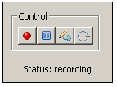
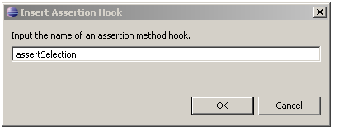
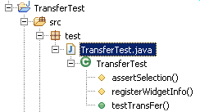
WindowTester Test Example
1. Launch Recording Session
, Assertions
2. Record Actions
3. Generate Test
Controller

Slide 53

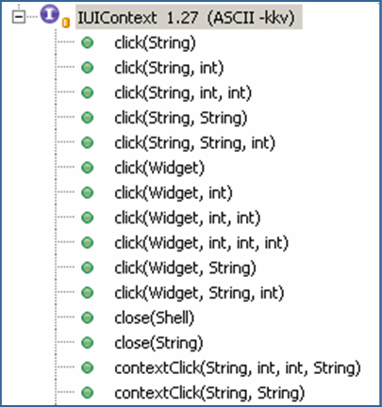
WindowTester Test Example
public class TransFerTest extends UITestCase {
/* Test method.*/
public void testTransFer() throws Exception {
IUIContext ui = getUIContext();
ui.click(“Transfer.menuitem", "Trans&fer");
ui.waitForShellShowing("TransFer");
ui.click("tree", "home/jsmith/docs/report.pdf");
ui.close("TransFer.transfershell");
ui.waitForShellDisposed("TransFer");
}
protected void registerWidgetInfo() {
IUIContext ui = getUIContext();
ui.register("tree", new WidgetLocator(Tree.class, new WidgetLocator(
Group.class, "/home/jsmith/docs/report.pdf")));
ui.register("&File.menuitem", new WidgetLocator(MenuItem.class, "&File"));
ui.register("TransFer.transfershell", new WidgetLocator(TransferShell.class, "TransFer"))
ui.register(“Transfer.menuitem", new WidgetLocator(MenuItem.class, “Transfer"));
}
protected void assertSelection { }
}
JUnit Testcase
UI Facade
Playback Synchronization
Widget Registration

Slide 54
WindowTester Integration
WindowTester, like abbot, is easy to integrate
Add a few jars / plug-ins
Based upon JUnit
  Leverages Eclipse Test Framework Test Runner
Easy to integrate into automated build systems
  Ant
  Cruise Control
  Maven
  …

Slide 55
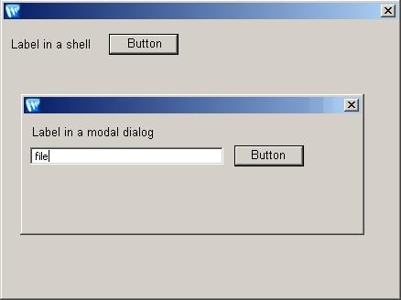
Challenge 1: Finding Widgets (WindowTester)
Uses a matcher scheme like abbot
  WidgetLocators ~= Matchers
Find Strategies
  widget hierarchy
  by name
IUIContext ui = getUIContext();
Widget w = ui.find(new WidgetLocator(…));
Example: Test needs to find “Button” in a modal dialog

Slide 56
Challenge 1: Finding Widgets (WindowTester)
Recall Abbot:
Abbot begins it search from the root
Full hierarchy information is always required.
Best way to find a Widget is to set a name in the data container of the Widget:
button.setData(“name”, “shell.button”);
<root>
Shell
Shell
Comp
Label
Comp
Label
Comp
Text
Button
Button

Slide 57
Challenge 1: Finding Widgets (WindowTester)
WindowTester:
<root>
Window Tester is context-aware when searching for widgets
Best way to find a Widget is to set a name in the data container of the Widget:
button.setData(“name”, “shell.button”);
Shell
Shell
Comp
Label
Comp
Label
Comp
Text
Button
Button

Slide 58
Challenge 2: Verifying UI State (WindowTester)
How to verify that aspects of the UI are as you expect them?
  Widget existence is verified when accessing the widget
How to verify state changes as a result of UI operations?
  WindowTester tests are simply JUnit tests, so…
    selection = ui.click("tree", "home/jsmith/docs/report.pdf");
    assertEquals("report.pdf", treeTester.getText(selection[0]));
Need to use abbot testers for access
(to ensure on UI thread)
// -- or --
ui.getDisplay().syncExec(
new Runnable(){
public void run() { … }
});

Slide 59
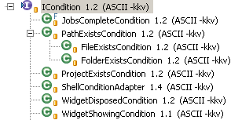
Challenge 3: Staying In-Sync (WindowTester)
How does a test handle a long running operation?
For example:
  new ProgressMonitorDialog(shell).run(true, true, op);
IUIContext ui = getUIContext();
ui.wait(new ICondition() { … });
Abbot-style conditions

Slide 60


Challenge 4: The Unpredictable (WindowTester)
How does a test handle an unexpected dialog?
For example:
  MessageDialog.openWarning(shell, "Access Error", message);
Shell Monitor
Regularly tests and handles shell conditions
IUIContext ui = getUIContext();
IShellMonitor sm = (IShellMonitor)(ui.getAdapter(IShellMonitor.class));
sm.add(new IShellConditionHandler() { …});

Slide 61
Challenge 5: Platform Differences (WindowTester)
Labels might be different
  Use regular expressions for New menu item
  "&New\t(Shift\\+Alt|Alt\\+Shift)\\+N/P&roject...”
Default selection event
  WindowTester tests are JUnit tests, so use Java syntax such as
  clickCount = Platform.isWindows() ? 2 : 3;
  ui.click(text, clickCount);
Eclipse UI changes over time 3.0… 3.1… 3.2… etc.
  Use regular expressions to smooth over path differences
  “(Simple|General)/Project”

Slide 62
Challenge 6: Maintaining Tests (WindowTester)
Text changes involve minor code changes
  From:
  ui.click(“Session.menuitem”, “Disconnect");
  To:
  ui.click(“Session.menuitem”, “Terminate");
Significant Widget Locator changes can be more difficult
(but scoping rules help)
Example: from Tree representation to Table…
Can (and should) be mitigated by naming (best practice!)

Slide 63
Challenge 7: Test Driven Dev. (WindowTester)
How to write tests for a UI that is
incomplete or does not yet exist?
WindowTester tests are JUnit tests,
so writing new tests by hand is possible
IUIContext ui = getUIContext();
ui.click(“Transfer.menuitem", "Trans&fer");
ui.waitForShellShowing("TransFer");
ui.click("tree", "home/jsmith/docs/report.pdf");
Hardest part is widget location
can be mitigated by naming widgets

Slide 64
WindowTester Pros and Cons
Pros:
Very flexible… full expressive power of java
Easy to integrate… just a few jars
Cons:
Need to use abbot-style testers to access UI state
Refactoring can be laborious
  Association between String handles and WidgetLocators needs
  to be manually preserved

Slide 65
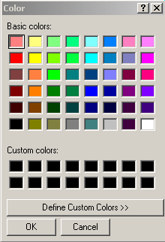
Other UI Testing Challenges
8. Complex/Hybrid Environments
  Multiple processes (e.g. external tools)
  Mixed Widget Systems
    Swing and SWT
      Complex thread interactions
  Native Dialogs (e.g., Color Chooser)
  VERDICT: None fare well…
9. Debugging UI Tests
  Abbot & WindowTester: standard step-through debugging
  TPTP: limited support

Slide 66


Other UI Testing Challenges (continued)
10. Playback Fidelity
  No approach exactly reproduces actual user events
    Native mouse clicks vs. Synthesized clicks vs.
    Selection Events
    Clicks vs. keystroke navigation
  Can have consequences if the application-under-test expects one kind of event and the playback mechanism provides another
  Made difficult because widget systems not designed for automation
    Not all components make
    their bounds known

Slide 67
UI Challenge Summary
 | Abbot | TPTP | WindowTester
1. Finding Widgets | Hierarchy, Finder, Matchers | Widget Resolver | Hierarchy, UIContext, Locators
2. Verifying State | JUnit, Testers | JUnit, Verifiers | JUnit
3. Staying In-Sync | Pauses, Conditions | Waits | Pauses, Conditions, Condition Monitor
4. Handling the Unexpected | … | ? | Condition/Shell Handlers
5. Platform Differences | Wildcard Matchers | ? | Wildcard Locators
6. Maintaining Tests | Yes | Difficult | Yes
7. Support TDD | Yes | No | Yes
8. Complex/Hybrid Env | Not well | No | Not well
9. Debugging UI Tests | Standard Eclipse Debugging | Limited | Standard Eclipse Debugging
10. Playback Fidelity | Not exact | Not exact | Not exact

Slide 68
UI Testing Comparison
 | Manual | Abbot | TPTP | WindowTester
Platform/Env | Any | AWT/Swing, SWT, RCP | Eclipse | AWT/Swing, SWT, RCP
Authoring | Prose | Idiomatic, Copy-Paste | AGR | Record and Refactor
Audience | Developers , QA | Developers | Developers , QA | Developers , QA
Test Execution | Manual | PDE launching infrastructure | Agents… | PDE launching infrastructure
Macros | N/A | Functions, for loops | Data pools | Functions, for loops
Unit-tests | N/A | YES (Testers) | NO (too coarse) | YES (Testers)
Functional-tests | N/A | YES | YES | YES
TDD | N/A | YES | NO | YES
Maintenance | Tedious | Java | XML | Java
Integration | N/A | Lightweight: JUnit, ant, CC | Heavyweight | Lightweight: JUnit, ant, CC

Slide 69
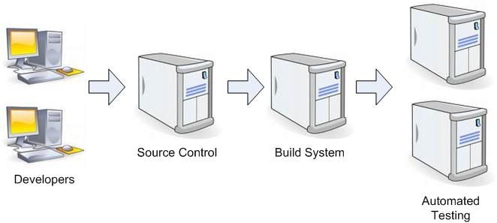
UI Test Automation at BEA
Code check-in starts the automated process
Servers run JUnit and WindowTester based tests
BEA Whitepaper Available at:
www.instantiations.com/PDFs/RCPDev_BEA_CaseStudy.pdf

Slide 70


Instantiations, Inc.
WindowBuilder™
WindowTester™
Visit our website at:
www.instantiations.com
Presentation Slides Available at:
www.instantiations.com/STPCon2006

